Slide 1

IBM Project Presentation on Hypervisor-Based Cloud Anomaly Detection using Supervised Learning Techniques
By
Group ID: G19
Rhythm Keyur Mendawala :18162101012
Krutik Yogeshkumar Shah :18162121035
Dhruv Rohitbhai Gajjar :18162171003
Institute of Computer Technology
Ganpat University
Date:5th May

Slide 2
Table of Contents
Introduction
Objectives
Related Background
Tools & Technology
Methodology (Modules)
Flowchart & Algorithms
Implementation Details
Conclusion
References

Slide 3
Introduction
This project is about to detect different logs and analyse it. Basically anomaly detection is the recognition of suspicious activities like attacks on system.
Log analysis is the process of examining, interpreting, and understanding computer-generated details known as logs. Logs are generated by various technologies including network devices, operating systems, applications, and many more. Log consists of a series of messages in time-sequence that describe activities going on within a system.
From this file we have to find the solution so that in future there will be no anomaly in that system.

Slide 4
Objectives
Generate different types of logs.
Log Analysis

Slide 5
Related Background
Nowadays as we know that as technology increases the complexity also increases and due to more complex structure it cause more bugs and security holes. Detection of anomaly become more challenging then ever before.

Slide 6
Tools & Technology
Virtual Box as Host machine
Splunk and Snort for log analysis and log management
Normal windows for attacking
Cyber security tools for attacking like LOIC
IBM and AWS Cloud

Slide 7
Methodology (Modules)
First of all, we are collecting logs from our system using Snort tool by continuously keeping our system working for a week or more.
Then we will try to attack on our system oftenly.
After gathering the logs we will change them into some understandable format to understand.
After proper formatting of the logs we will assess the logs for anomaly detection using Splunk, Fiddler.

Slide 8
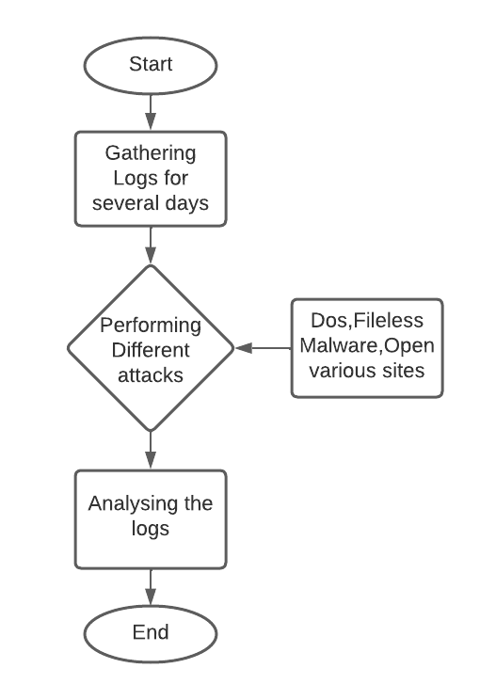
Flowchart & Algorithms

Slide 10
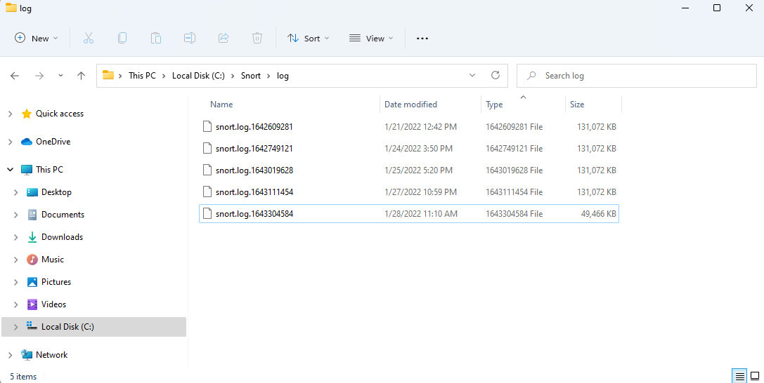
Implementation Details
Total logs generated after eight days.

Slide 11
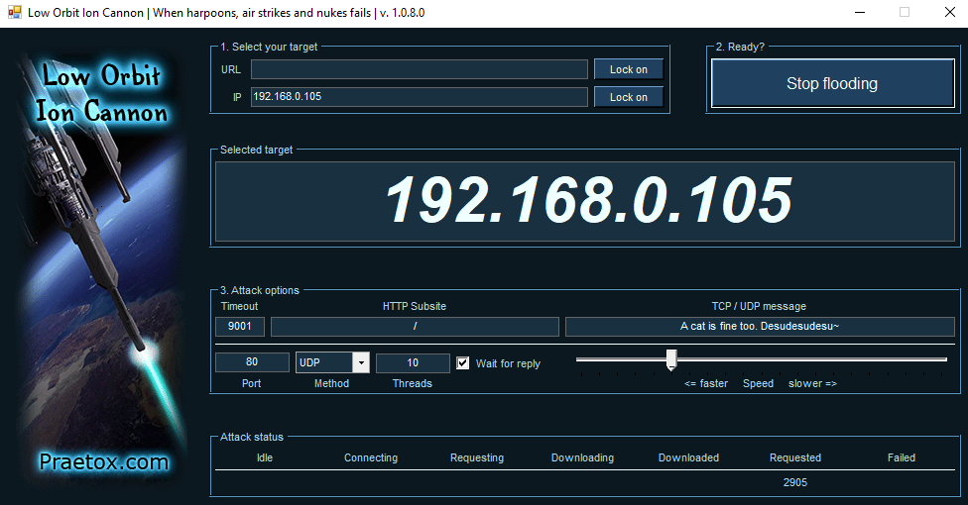
Dos attack using LOIC Tool

Slide 12
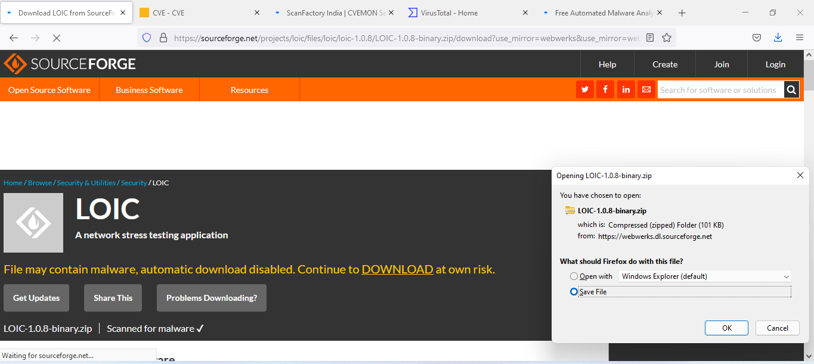
Opening different type of websites: Legitimate as well as non-legitimate and trying to download some content

Slide 13
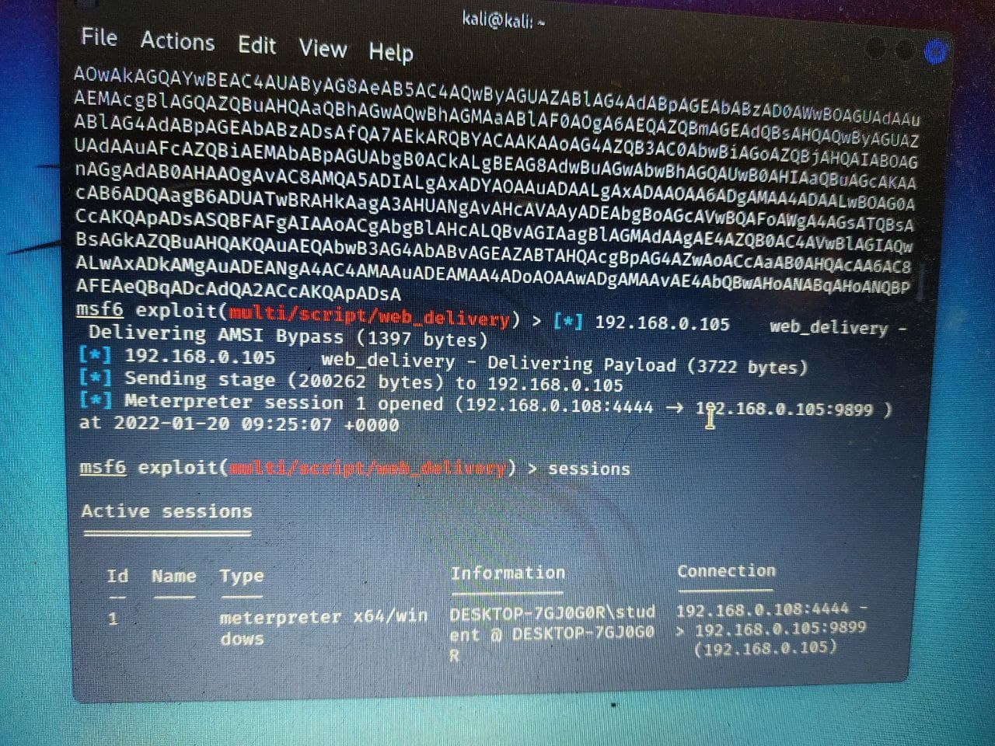
Fileless malware attack using metaspolit tool of kali linux

Slide 14
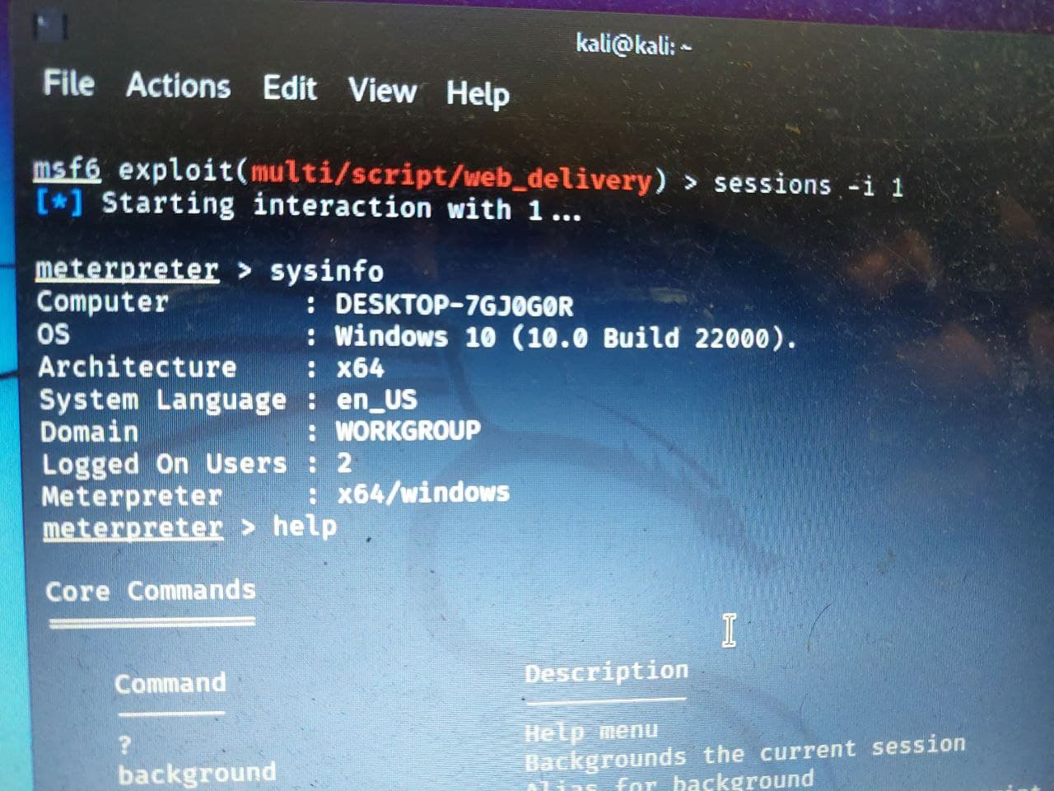
Fileless malware system information

Slide 15
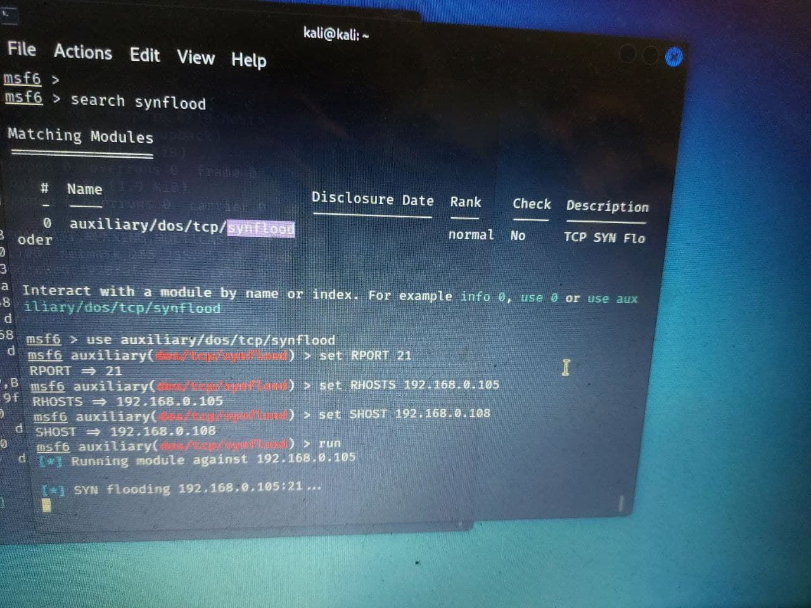
Synflood dos attack using metaspolit tool of kali linux

Slide 16
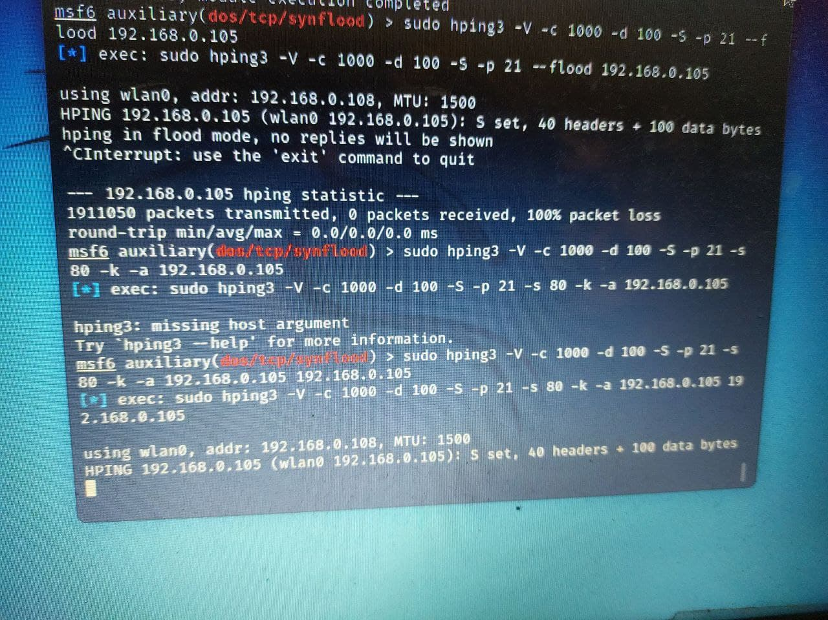
Dos attack using hping3 tool of kali linux

Slide 17
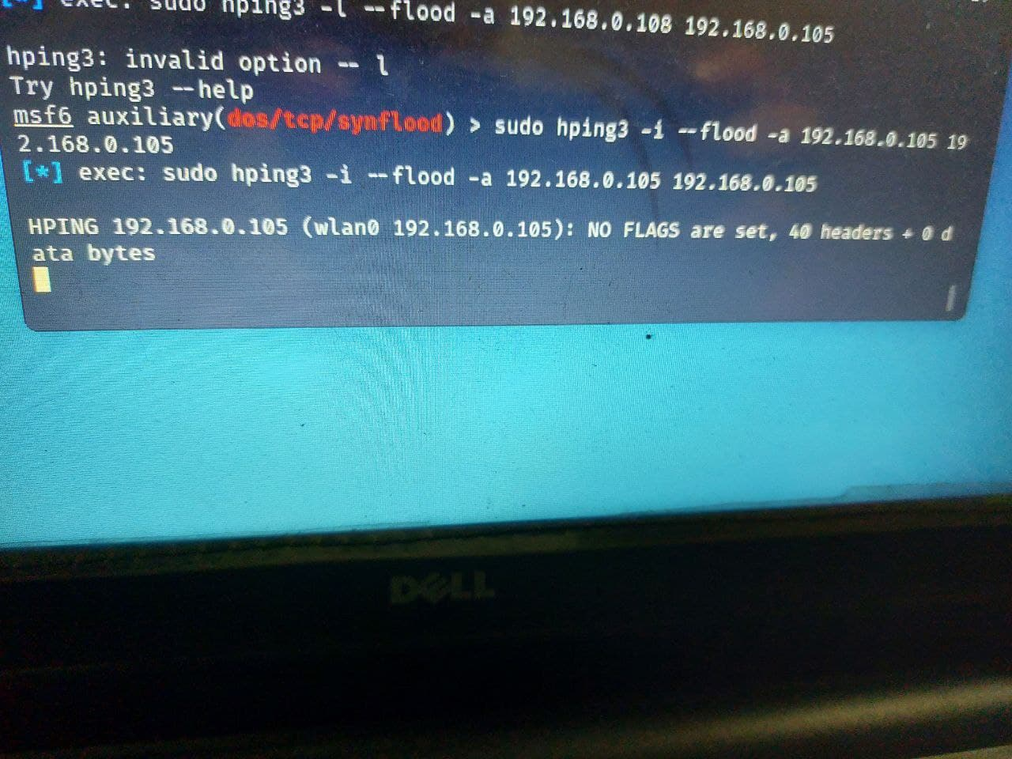
Dos attack using hping3 tool of kali linux

Slide 18
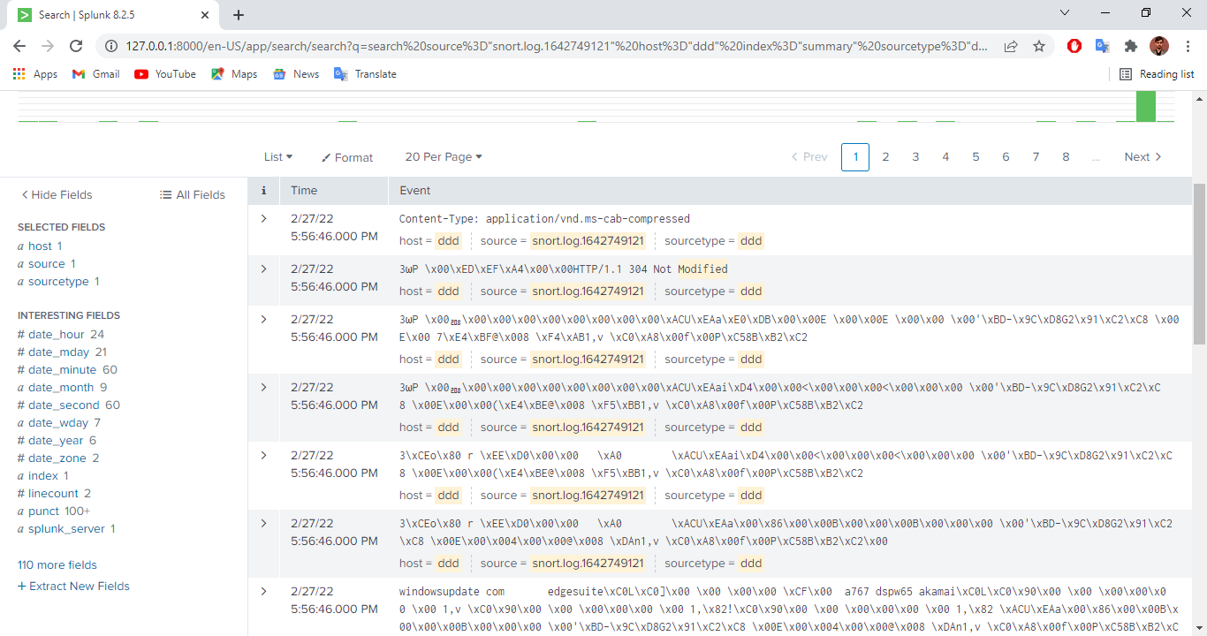
Reading Logs that we have generated

Slide 19
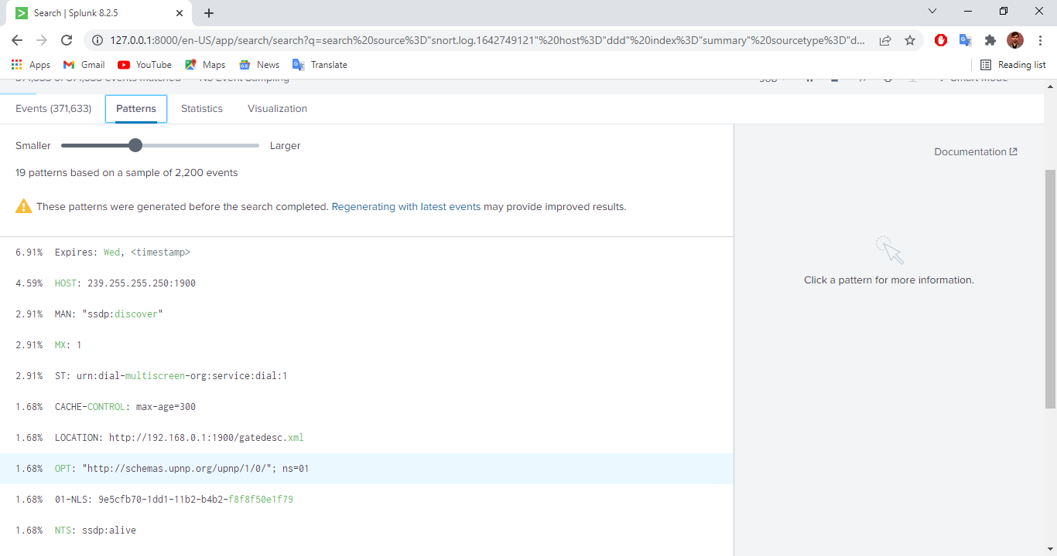
Finding some patterns based on logs

Slide 20
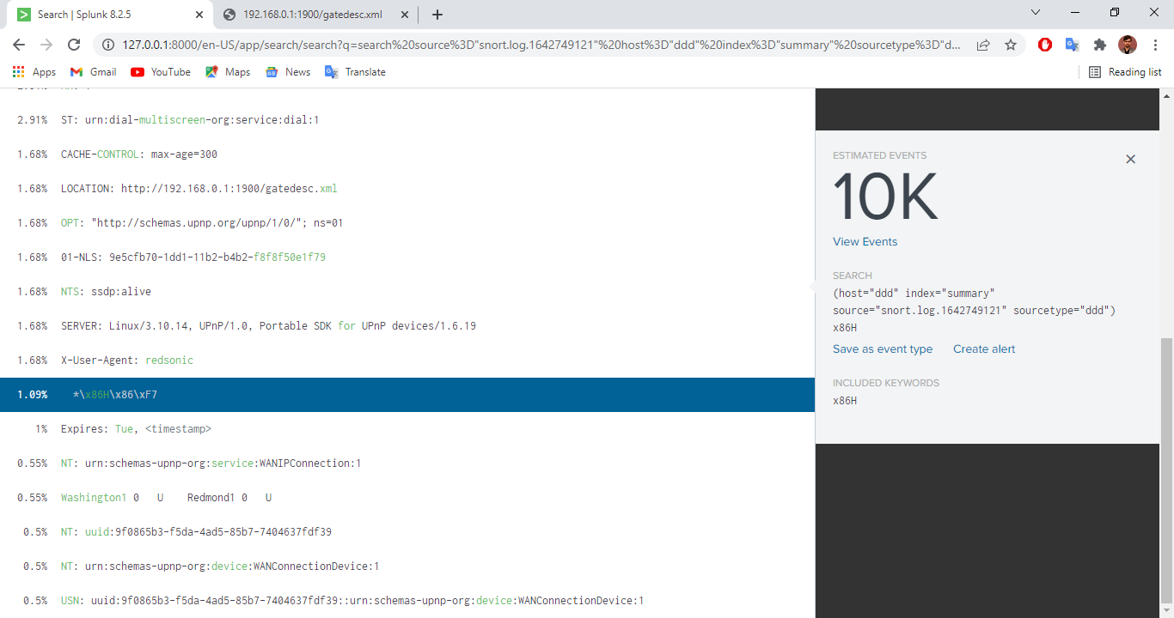

Slide 21
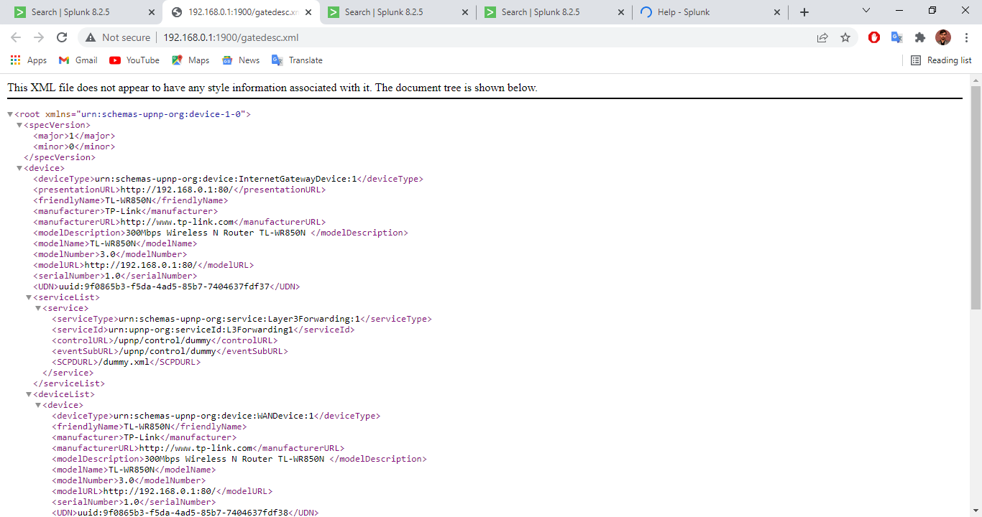
We are getting the html code of the website which is in our log files.

Slide 22
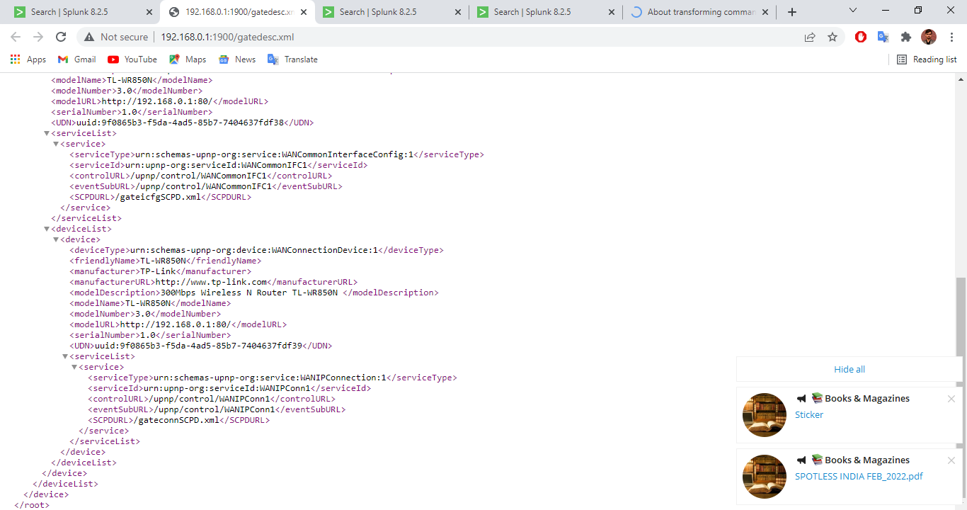

Slide 23
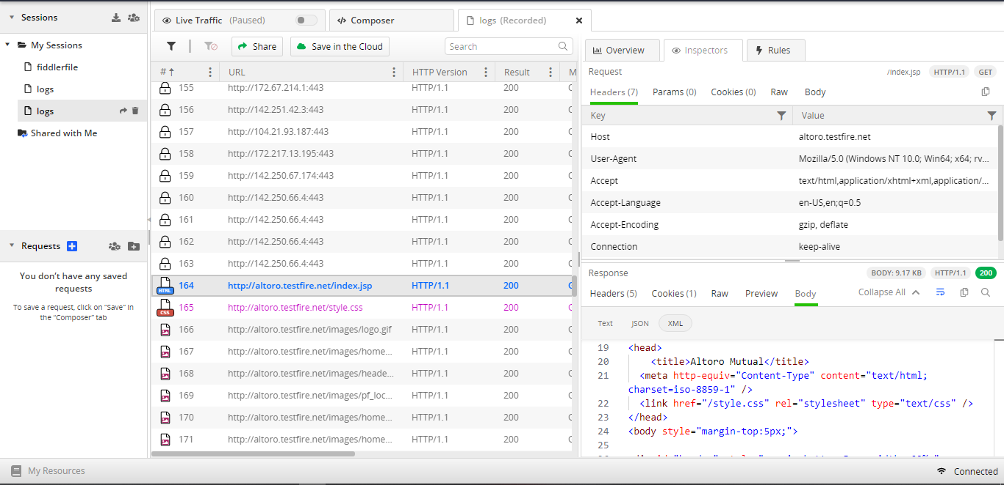
Analysing Http request using Fiddler

Slide 24
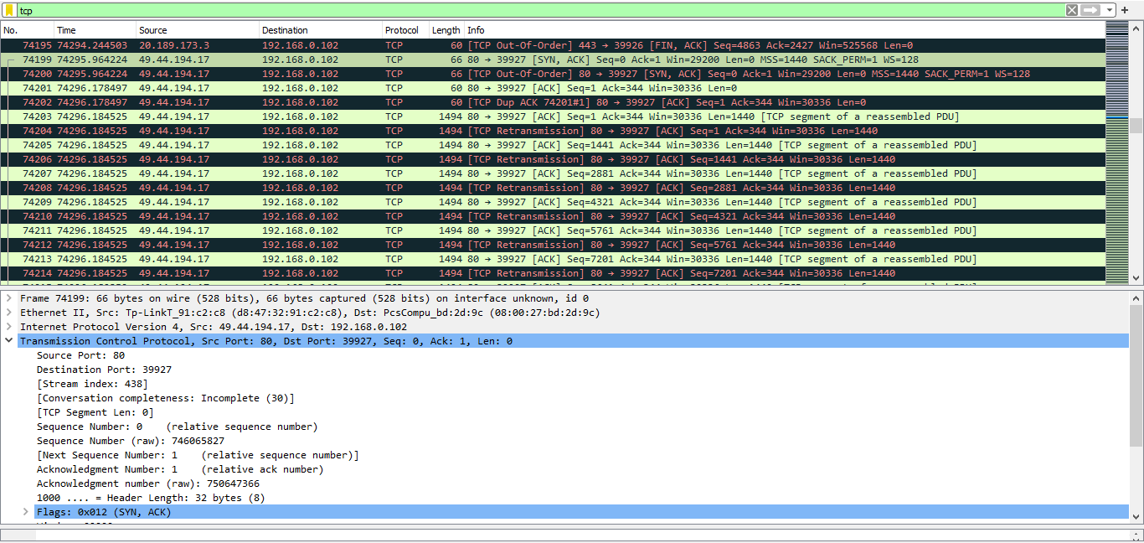
Filtering Tcp protocol in Wireshark

Slide 25
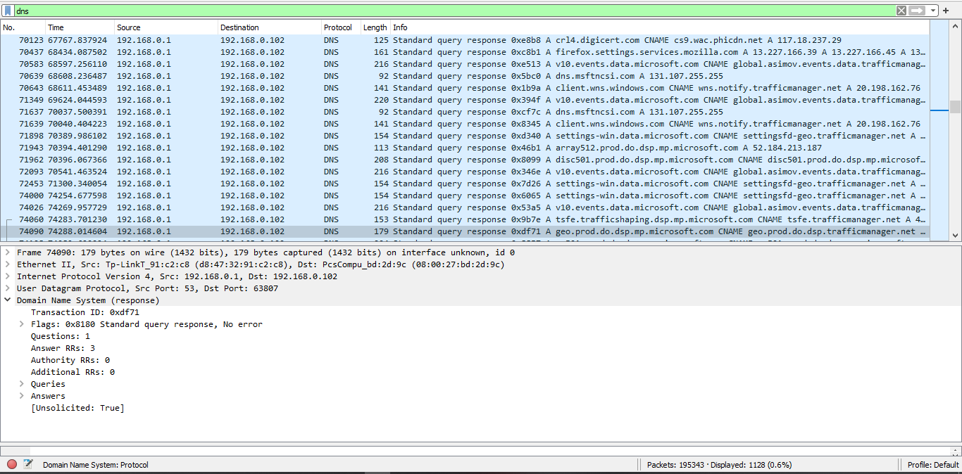
Filtering DNS protocol in Wireshark

Slide 26
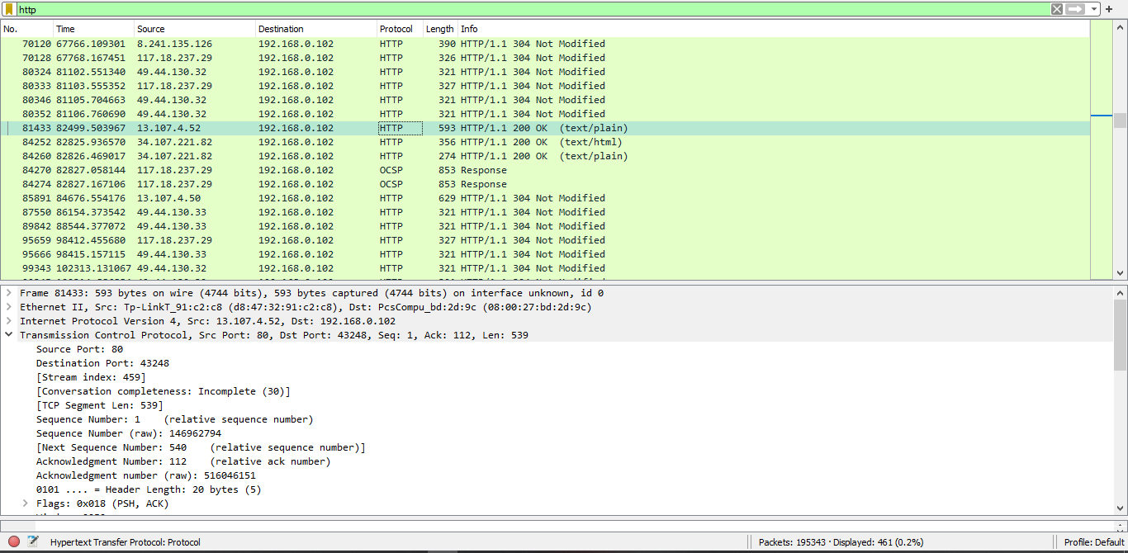
Filtering Http protocol in Wireshark

Slide 27
Anomaly Detection in IBM Cloud
Types of Anomaly Detection can be classified into 3 types based on the availability of the data →
Supervised Anomaly Detection targets to construct a predictive model using labelled dataset which contains both normal and anomalous samples.
Unsupervised Anomaly Detection targets to construct a model using unlabelled dataset. It assumes that most data points in the dataset are normal and so it searches for the data points which are different from the normal data points.
Semi Supervised Anomaly Detection aims to utilize such labelled samples, but most proposed methods are limited to merely including labelled normal samples. Only a few method takes advantages of labelled anomalies.

Slide 28
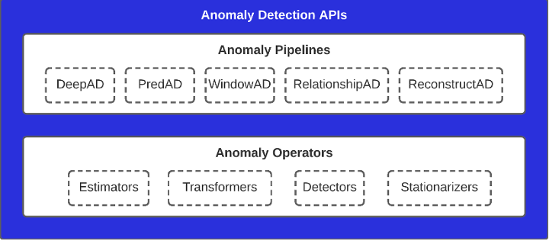
Anomaly Detection in Time series →
Time series are the observations that have been recorded in an orderly manner and which are correlated in time.
When we are analysing time series data, we should make sure of the outliers the same way we do it for the static data.
Anomaly Detection API’s →

Slide 29
Anomaly Operators →
The lower layer consists of the Anomaly operators, which are the basic operations like Estimators, Transformers, Detectors and Stationarizers.
These components perform one specific task and hence are referred to as Operators.
Anomaly Pipelines →
The upper layer consists of Anomaly pipelines. It is used to implement advanced machine learning primitives in the form of an anomaly pipeline which connects the lower layer.
Types of anomaly pipelines →
PredAD
DeepAD
RelationshipAD
WindowAD
ReconstructAD

Slide 30
DeepAD uses an ensemble of time series forecasting model whereas PredAD uses single time series forecasting model. We can say that DeepAD is the plural form of PredAD.
RelationshipAD has a pair wise relationship between the variables for the anomaly detection by comparing the behaviour of relationships between variables under normal operation with that of the relationships observed during a test period.
WindowAD performs windowing on the time series data to generate sequential windows at each data point and performs anomaly detection on the tabular data that is generated by flattening the time series.
ReconstructAD is an algorithm that performs anomaly detection based on the reconstruction of the original data and comparing the quality of reconstruction to detect anomalies.

Slide 31
Also each pipeline is capable of generating anomaly labels(+1 for normal Sample and -1 for anomalous) in the form of Anomaly Thresholding.
Anomaly labelling methods are of 2 types, Static and Dynamic.
Static thresholding provides a single-value threshold for the entire range of anomaly scores, and all anomaly score values greater than this threshold are labeled as an anomaly.
Dynamic thresholding provides changing or contextual thresholds throughout the range of the scores, and anomaly score values that are greater than their corresponding dynamic threshold values are labeled as an anomaly.

Slide 32
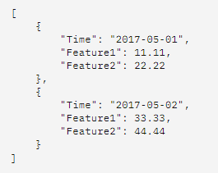
Anomaly Detection ON UNIVARIATE DATA
Steps →
1. Authentication → Here all API request requires the authentication information, which includes CLIENT ID and CLIENT SECRET. You can get this by clicking on get trial subscription, registering for free trial using your IBM ID. Go to the Dashboard. Then search for the Anomaly Detection API and click on it. Click on the dropdown arrow and you will see that those two credentials are available in the key management section.
2. Connection Check → Now the next task is to verify that the anomaly detection service is up or not. For that go to connection check tab, click on try this API button and give the CLIENT ID and CLIENT Secret values which you retrieved from step 1, click on run request. If the service is connected you will see a response message that the anomaly detection service is up. You can add the code snippets of different languages in your program by selecting your desired language in the code snippet session.
3. Create a dataset → For implementing our anomaly detection service, we need a CSV or JSON datafile. The data format for JSON file should be as follow →

Slide 33

Anomaly Detection ON UNIVARIATE DATA
4. Create a dataset → For implementing our anomaly detection service, we need a CSV or JSON datafile. The data format for CSV file should be as follow →
5. Submit an Anomaly Detection job → Navigate to the submit anomaly detection job tab and select Detect anomalies for univariate time series. Click on try this API, fill the CLIENT ID and CLIENT SECRET. Give the parameter values according to your choice and click on run request to send a request and submit a job. Once the job would run successfully, it will return a JOBID which is necessary for the next step.

Slide 34
Anomaly Detection ON UNIVARIATE DATA
6. Get Result → Once a job is successfully submitted, the service will perform data quality checks and run the anomaly detection on the data. The execution time is dependent on the data size, parameter selections, e.g. algorithm type, and the current number of job submissions. Navigate to get result tab, click on try this API and give CLIENT ID and CLIENT SECRET. Give the JOB ID you got from the last step and click on run request. If the job is done, the result of each sample will be returned with anomaly scores and other details.

Slide 35
Trying to generate logs in IBM cloud using IBM LOG ANALYSIS
Steps →
Login to your IBM account.
Click on catalog and you will see the services available in ibm cloud.
Now in services search for logging and monitoring category.
Now click on IBM log analysis block.
The following screen will be visible, so select the region, select the lite plan and give the name of the service.
To provision the IBM Log Analysis service in the IBM Cloud selected resource group, click create.
Then the IBM log analysis dashboard opens.
Go to the menu icon > observability to access the Observability dashboard.
Click on logs → options and then edit platform.

Slide 36
Trying to generate logs in IBM cloud using IBM LOG ANALYSIS
10. Select a region from the drop down list.
11. Select the instance you created → Click select
12. Open ibm cloud cli or command prompt and login to you’re ibm account.
13. Give commands → ibmcloud login, give mail id and password, and select the account you want to use.
14. Select the region.
15. Set the resource group which is there in your instance, in this case it is default.
16. Switch to IBM cloud tab and search for cloud foundry.
17. Click on create a cloud foundry app.
18. Select the location, give the name to the app and click on create.
19. After that we will try to connect the cloud foundry app to the IBM log analysis service.

Slide 37
Anomaly Detection in AWS Cloud
EC2 →
EC2 stands for Amazon Elastic Compute Cloud.
Amazon EC2 is a web service that provides resizable compute capacity in the cloud.
Amazon EC2 reduces the time required to obtain and boot new user instances to minutes rather than in older days, if you need a server then you had to put a purchase order, and cabling is done to get a new server which is a very time-consuming process. Now, Amazon has provided an EC2 which is a virtual machine in the cloud that completely changes the industry.

Slide 38
Anomaly Detection in AWS Cloud
IAM →
IAM stands for Identity Access Management.
IAM allows you to manage users and their level of access to the AWS console.
It is used to set users, permissions and roles. It allows you to grant access to the different parts of the AWS platform.
AWS Identity and Access Management is a web service that enables Amazon Web Services (AWS) customers to manage users and user permissions in AWS.

Slide 39
Anomaly Detection in AWS Cloud
CloudWatch →
Amazon CloudWatch is a monitoring and management service that provides data and actionable insights for AWS, hybrid, and on-premises applications and infrastructure resources.
Amazon CloudWatch is basically a metrics repository.
An AWS service—such as Amazon EC2—puts metrics into the repository, and you retrieve statistics based on those metrics. If you put your own custom metrics into the repository, you can retrieve statistics on these metrics as well.

Slide 40
Steps for CloudWatch Service
Login to you AWS management console.
In search bar, search for IAM service and open it.
Let the IAM dashboard open, then click on policies section to create policies.
Click on create policy and write the code in json.
Give the name to the policy, review all the settings and click on create policy.
Once the policy is created, check whether it appears in the list of the policies.
Now go to roles section, and click on create role for creating a new role.
Select entity type as AWS service, use case as EC2 and click on next.
Now in permissions sections we need to select the policy which we created recently.
In step 3, give the name of the role and review the other settings and click on create.

Slide 41
Steps for CloudWatch Service
11. The role will be created.
12. Next we will create EC2 instance whose logs are to be collected.
13. Click on instances and then launch instances.
14. Choose AMI as Amazon Linux AMI, click on next, select family as t2.micro and click on next.
15. In step number 3, keep all the settings as default.
16. In user data, write the script.
17. In step number 4, keep everything as default, click next and give tags.
18. Create a new security group having protocol SSH and source as my IP, then click on review and launch.
19. Click on create a new key pair, give the name of the key pair and then download it so that you can easily login in that instance.
20. As you can see the instance is created, wait for its status to become running.

Slide 42
Steps for CloudWatch Service
21. Once the status turns to running, select your instance and go to actions → security → modify IAM role.
22. Choose the IAM role which you just recently created and click on save.
23. Now select the instance and click on connect for logging into the instance, go to SSH client tab.
24. Open git bash, go to the folder where the downloaded key was saved and give the following commands → chmod 400 key name → copy the command given in the SSH tab and paste it in the gitbash.
25. Now we need to connect this instance to the cloudwatch log service so, some installations needs to be performed. For that give the command “sudo yum install – y awslogs”

Slide 43
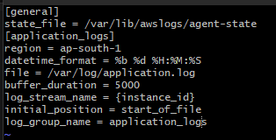
Steps for CloudWatch Service
26. Then give the command sudo vim/etc/awslogs/awscli.conf
27. Then do the following changes the the vim file. Select the region as given below or you can also select the region where you want these logs to be stored.
28. Region = ap-south-1
29. The give the following command → sudo vim/atc/awslogs/awslogs.conf
30. Do the following edits in the vim file, save the file and exit the vim file.

Slide 44
Steps for CloudWatch Service
31. Next give the command → Sudo service awslogsd start
32. Give command → cd /var/log → sudo su → ls and you will see the list of existing files in that folder.
33. Create a dummy file containing dummy data as logs. Now if everything is well we should see this data in the cloudWatch service.
34. Go to CloudWatch service tab and in logs section go to log groups. You will see that the dummy log file which you just created is now shown here.
35. Open it, and you will see the log stream, click on it and open it.

Slide 45
Steps for CloudWatch Service
36. You will see that the data you entered in the dummy file is now shown here.
37. Now enter some more messages to see is it working live or not.
38. And you will see that it is working live.
39. Now we will create a metric filter, for this you need to select your log group → actions → create metric filter.
40. Select filter pattern as ERROR to check weather the data contains error message or not.

Slide 46
Steps for CloudWatch Service
41. Give the name of the filter according to your choice.
42. Give the metric name and leave all other settings as default.
43. Review it and click on create.
44. You will see that metric filter is already created.
45. Select it and click on create alarm to get a notification each time there is a error in the system.
46. Give the metric name, threshold type as static and give the alarm setting as greater than threshold value 0, then click on next.

Slide 47
Steps for CloudWatch Service
47. In step 2, keep alarm state trigger as in alarm and select an SNS topic as create new topic, give the name of the new topic and give the email ID in which you want to get the notifications.
48. In step 3, give the alarm name and click on next. Review all the settings and click on create.
49. As you can see that the alarm is created, now for getting email notifications you need to go to SNS service, select your topic and click on confirm subscription and go to mail and click on confirm subscription.
50. Now it is showing that the data is insufficient, so we will add some more lines to our log file and also add some error files to see if it gives the notification and alarm or not.

Slide 48
Steps for CloudWatch Service
51. As you can see that all the data is added in the cloudWatch service including the error messages.
52. Go to alarm section and you will see that it is showing the state in alarm, it is because we have added the error messages in the log file.
53. You can also see that it has send the email to the selected mail id that the CloudWatch service is in alarming state.

Slide 49
Conclusion
In this project we have generated different types of logs and analysed it using analysing tool. From this we are understanding the logs and try to analyse from it. Apart from this, we also tried to perform the same in IBM and AWS clouds.

Slide 50
References
https://www.cs.utah.edu/~lifeifei/papers/deeplog.pdf
https://www.dnsstuff.com/free-siem-tools#splunk-free
Security Information and Event Management SIEM Implementation Network (Book)
https://www.splunk.com/en_us/download.html Splunk Enterprise
https://www.splunk.com/en_us/download/universal-forwarder.htmlSplunk Forwarded
https://www.snort.org/ snort
https://docs.splunk.com/Documentation/Splunk/8.2.5/Installation/ChoosetheuserSplunkshouldrunas

Slide 51
Thank You !!

